Slide 1

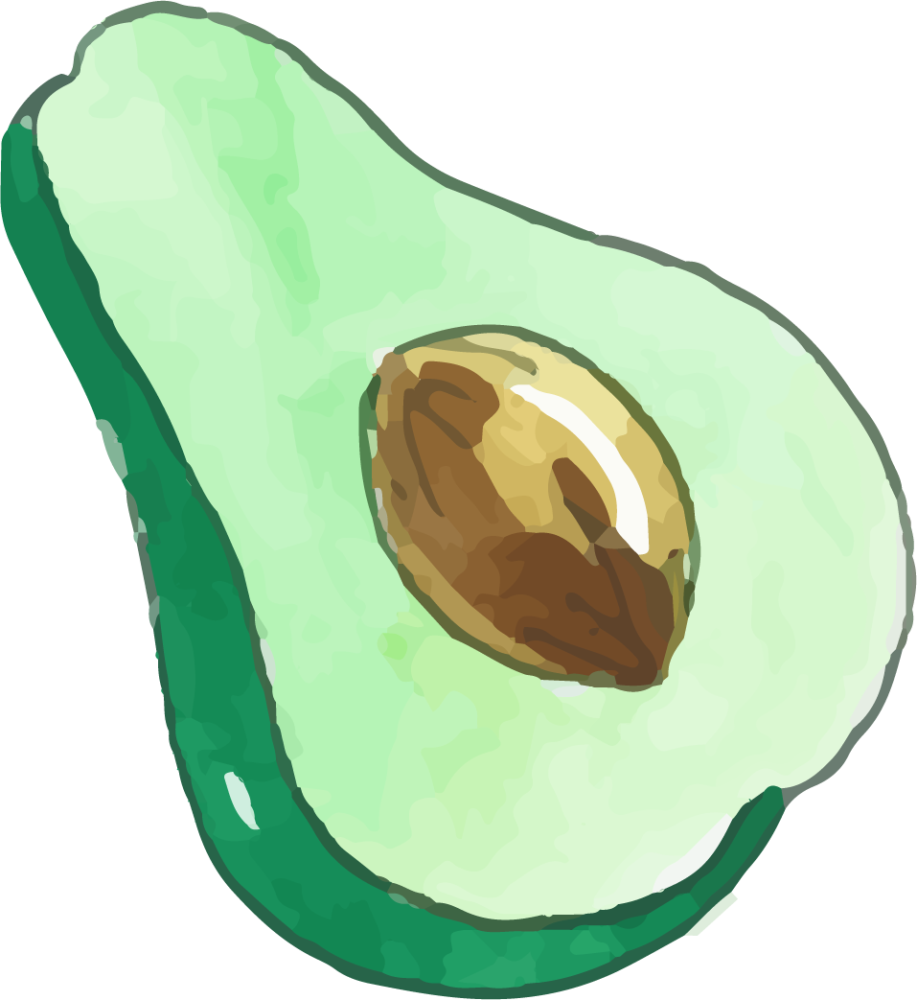





Veggie HuntAR
Submitted By:
Alekhya Ryali (110084315)
Anirudh Mayuram (110074659)
Dheeraj Jayachandra (110081327)
Karishma Chowdary Cherukuri (110076472)
Kush Hansraj Bhardwaj (110070548)
Neeraj Suhaas Atluri (110074572)
Vamshy Pagadala (110067384)
Venkata Keerthi Karnati (110074730)

Slide 2

Table of contents
01
02
04
05
03
Problem
Solution
Methodology
06
Design
Demo
Future works

Slide 3
01.
Problem
We will discuss needs of the customer and business-related problems

Slide 4

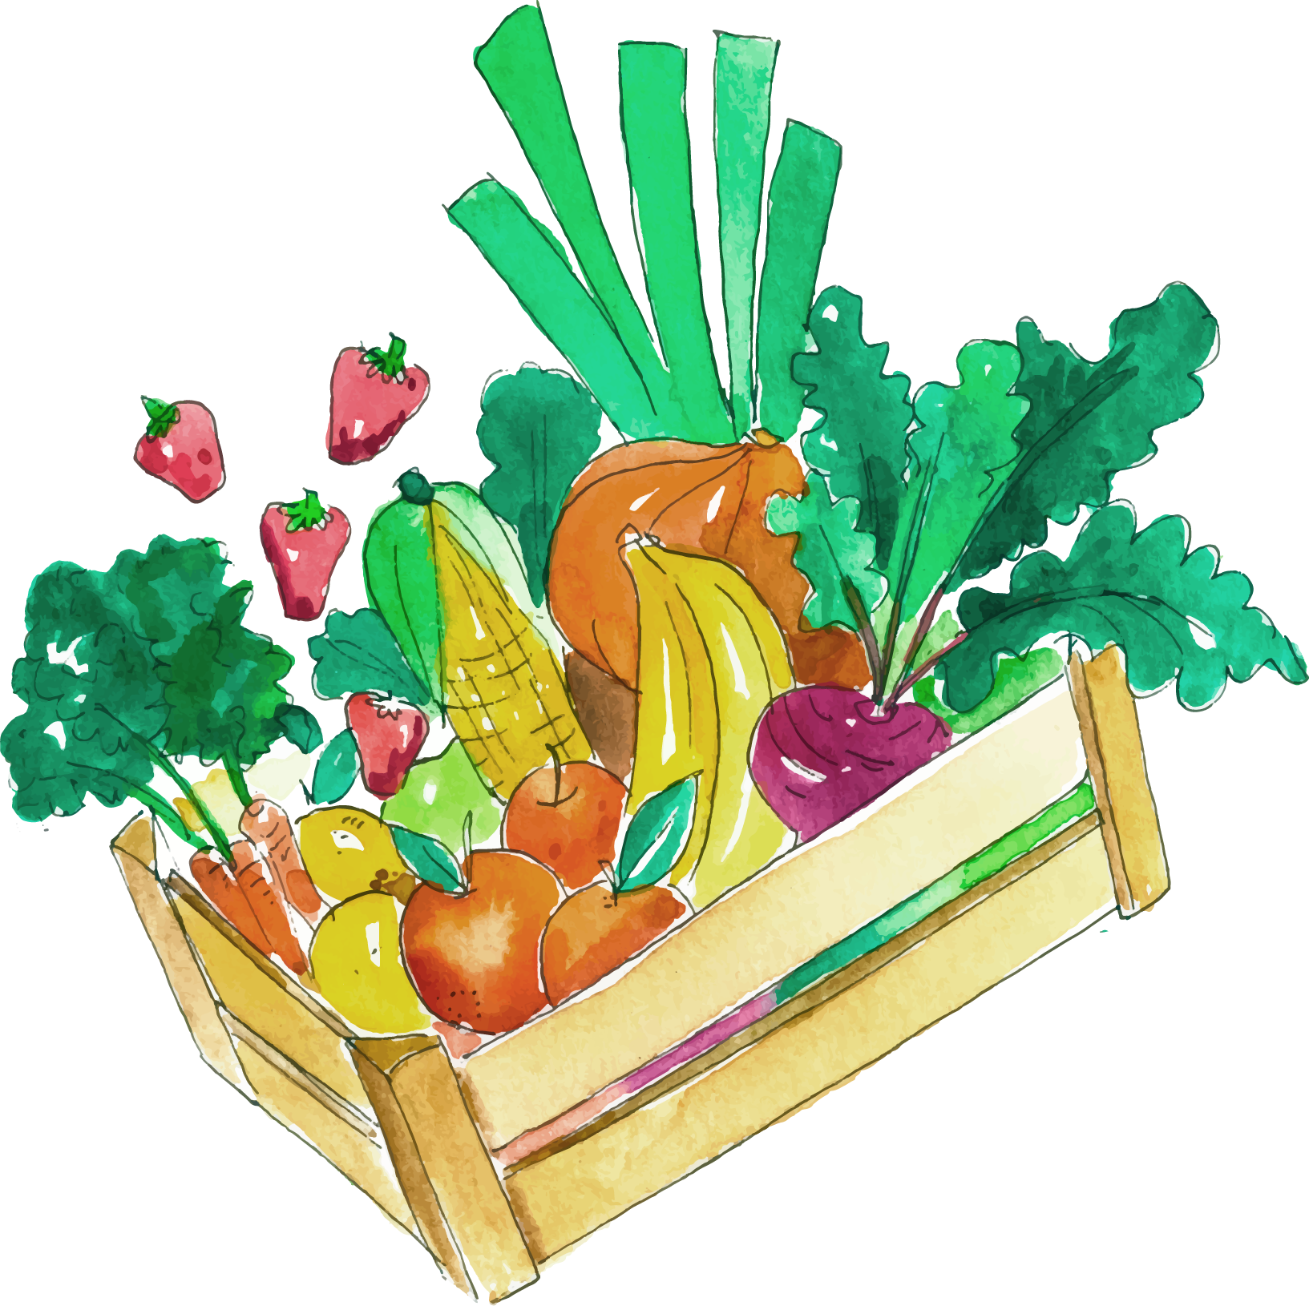
Needs of the Customer
The customer desired an augmented reality game that would be fun to play and incorporate cutting-edge technology.
Game should contain various 3D objects.
Game should contain Visual effects.
Game should be able to attract the age group 6-15 years.

Slide 5
Business Related problems
The growing affordability and availability of AR games on mobile devices is a prime factor driving the market growth.
Due to the continuous rise in needs, there is a drastic increase in innovations. Hence, we need to upgrade the product to survive in the market.
As players might feel bored with the game, we need to upgrade the UI of the game to make it more interesting.
This might cause an increase in the maintenance and up-gradation charges.

Slide 6

02.
Solution
We will discuss the following: main features, characteristics,Technologies, and Justification

Slide 7
Main Features
AR Feature
3D Objects
Shooting Feature
Timer Feature

Slide 8
Characteristics
Connecting the real world with the virtual world
Shooting the 3D Models with help of a weapon

Slide 9
Technologies & Justifications
Veggie HuntAR game’s main motto is to implement Augmented Reality (AR), which is nothing but connecting Real-world with the Virtual world.
Why AR?
Augmented reality, is a technique that adds layers to the world as we are used to it. These layers could be visual, auditory, and sensory information to intensify your experience. This helps players to be aware of and can still interact with their environment.
C# is used to develop the game and implement the game in multiple platforms.

Slide 10
03.
Methodology
We will discuss lifecycle, Tools, Pipelines, Quality Management, and Risk Management

Slide 11
Life Cycle
Scrum Methodology is used for Veggie HuntAR.
Team coordinates to assign the tasks
Daily standup Meetings are conducted to give an update and discuss the next day’s work.
Sprint planning meetings and Sprint Retrospective meetings are conducted to discuss the sprints

Slide 12



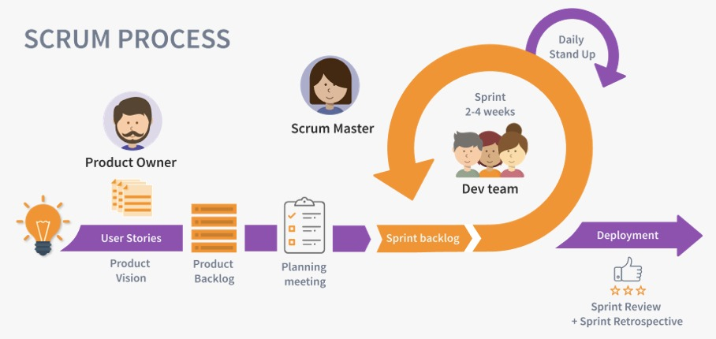
Scrum

Slide 13

Why Scrum?
Reduce Cost
Reduce Complexity
Reduce Development Time
Ensure High Quality
Efficient high end-product
Better collaboration and issue resolution
Short time span

Slide 14
Tools
Game Engine: Unity
Target devices: Android
IDE to write scripts: Visual Studio Code
Communication Tools: Teams.
Project Management: JIRA.
Version Control: GitHub

Slide 15
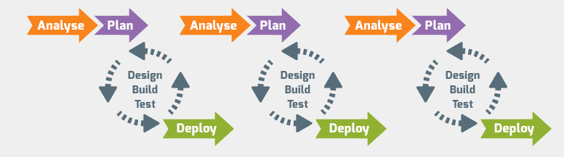
Pipeline

Slide 16


Quality Management
The act of overseeing various operations and duties during the project development to guarantee that the game and services are consistent is known as quality management.
We considered Quality management in all the aspects of the project from procedure to deployment, to maintain the quality.

Slide 17
Quality Management
We followed the four key components to maintain the quality of the project:
Quality Planning.
Quality Improvement.
Quality Control.
Quality Assurance.

Slide 18
Quality Management
As part of Quality Management, we have performed Testing on veggie HuntAR.
During Testing if any issue occurs testers would create the bug.
Developers would check the bug and fix it based on the priority and send fixes for retesting.

Slide 19
Quality Management
Code reviews
SRS , Design , code documentation .
Sprint meetings to enhance the quality of the product and the methodology
Test cases verification

Slide 20
Risk Management
In Risk management we identified, analyzed, and responded to risk factors that arise over the course of a game’s operations.
We anticipated the risk of “version compatibility” so initially, we identified and analyzed, and responded by considering only the latest version of tools to prevent issues.
We organized meetings daily to prevent and anticipate the possible risks along with the status update.

Slide 21
















Risk Management
Identify Risk
Assess Risk
Review Controls
Control Risk

Slide 22
Design
Initially player launches the application (Veggie HuntAR) and navigates to the splash screen.
Once the splash screen disappears user navigates to the main page and the user can start the game, Exit the game, and user can check about the game, and change the settings.
Once the user starts the game 3D models of veggies and fruits are displayed and the user can shoot the objects with the help of the knife.

Slide 23

Demo Video

Slide 24
Future Work: Improvement On The Game
We will develop new features to implement in the game that include:
Adding more game modes.
Adding a leader board to record the highest score.
Customizable themes and more objects to shoot.
Provide a tutorial on how to play the game and provide tips while playing.
Add iOS support.
Add Sound effects

Slide 25
Future Work: Improvement On The Methodology
In order to enhance and improve our methodology in the future, we can make the following changes:
Giving priority to the delivery of working software at every milestone.
Focusing on new features, instead of improving the feature from the previous milestone.

Slide 26
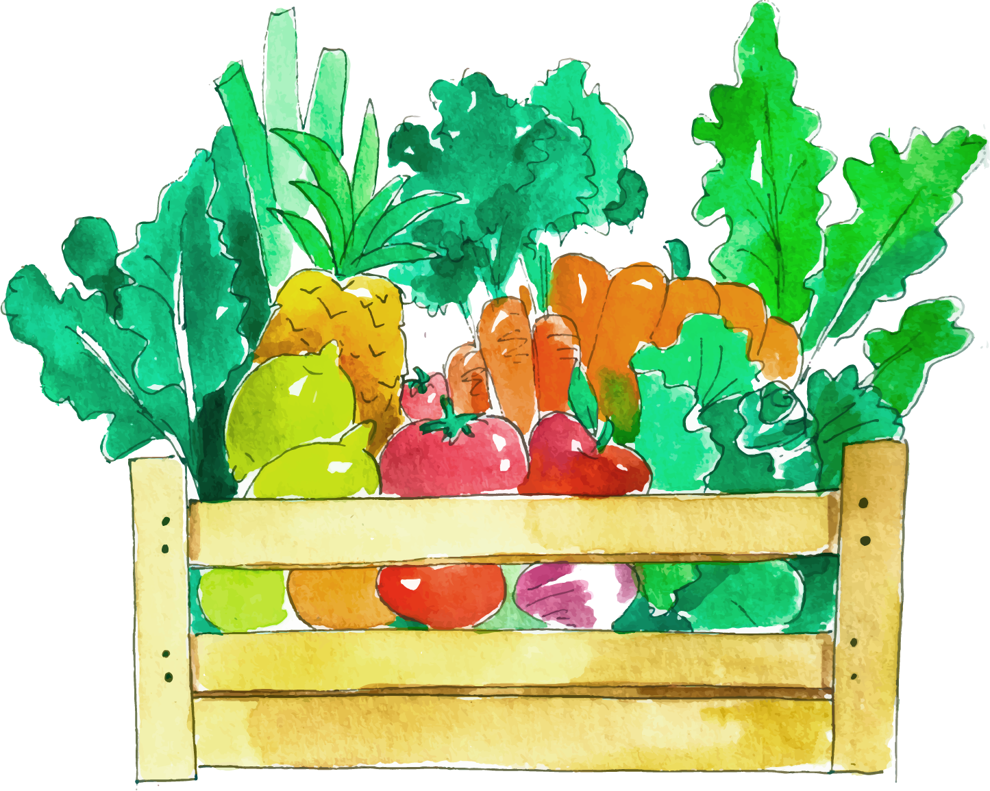
References
https://www.tuleap.org/agile/agile-scrum-in-10-minutes
https://www.atlassian.com/agile/scrum
https://corporatefinanceinstitute.com/resources/knowledge/strategy/risk-management/

Slide 27
Thank You

